Slide 1
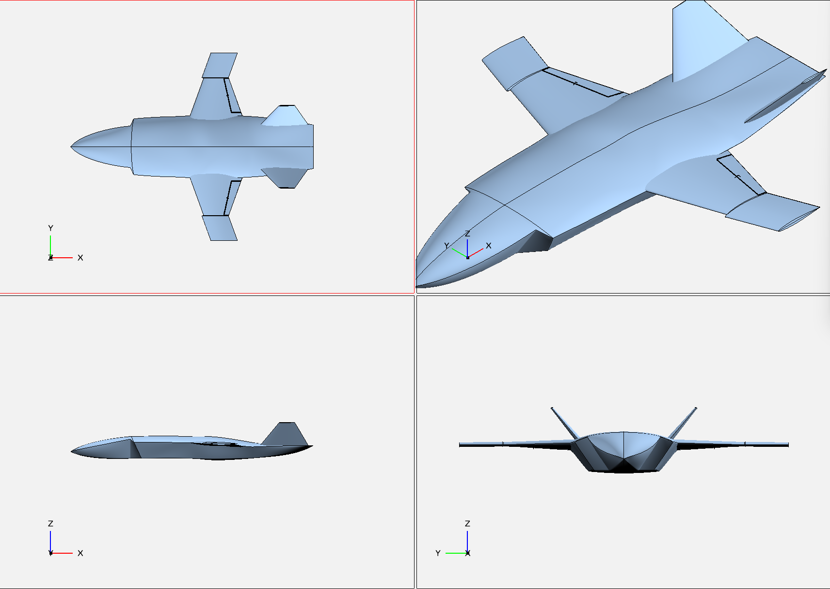
Design Configuration #1: AIRCRAFT NAME – Student Name
Dimensioned Top View
Key Configuration Parameters
Estimated Weight (units)
Wing Planform Area – S_{ref} (units)
Wing Loading – W/S (units)
Wing Aspect Ratio – AR
Wing Taper Ratio
Wing Leading Edge Sweep (deg)
Wing Airfoil
Fuselage Fineness Ratio
Drag Polar Model Equation
L/D max Estimate
Design Approach
Configuration vision / objective
Key Design Features & Driving Requirements which led to design choice
Key Design Features & Driving Requirements which led to design choice
Key Design Features & Driving Requirements which led to design choice
Configuration Strengths
Strength 1
Strength 2
Strength 3
Configuration Weaknesses
Weakness 1
Weakness 2
Weakness 3
Other Key Configuration Considerations
Fabrication:
Cost:
Schedule:
Other:
Dimensioned Side View
Dimensioned Front View

Slide 2
Lift Curve Model
Insert your Lift Curve Plot (CL vs Angle of Attack) here:
Include on the same plot
2-D airfoil lift curve
3-D wing lift curve model
Make sure plot is formatted adequately
Axis Titles + Units (if applicable)
Proper range used for both vertical and horizontal axes
Legend
Airfoil and Wing Parameters | Value
Airfoil Type
Wing AR
Wing Taper Ratio
Wing Sweep (at quarter chord)
Wing Model Span Efficiency (e)
 | Lift Curve Slope (1/deg) | Zero Lift Angle of Attack (α_{L=0} in deg) | Stall Angle of Attack (α_{stall} in deg)
2-D Airfoil | XXX /deg | XXX deg | XX deg
3-D Wing | XXX /deg | XXX deg
NOTE: None of your figures should include a “Benchmark Aircraft” line

Slide 3
Parasite Drag Model
Flow Properties
STD ATMOS Altitude
Mach
Reynolds Number (Wing)
Aircraft Geometry | Form Factor (FF) | Interference Factor (Q) | Wetted Area (Swet) | Reference Dimension
Fuselage |  |  |  | Fineness Ratio (l/d) =
Wing |  |  |  | S_{ref} = XX m^2
Horizontal Tail
Vertical Tail
Additional Drag | A_{base} | D/q | % L&P Assumed
Base Drag (misc) | XX m^2 | XX
Leakage & Perturbance |  |  | XX%

Slide 4
Induced Drag Models
Insert your Induced Drag Plot (CDi vs CL) here:
Include on the same plot
Induced Drag 3-D Wing-Only
Induced Drag Model using Cavallo Oswalds Model
Induced Drag Model using Nita-Scholz Oswalds Model
Induced Drag Model using Student Choice Oswalds Model
Make sure plot is formatted adequately
Axis Titles + Units (if applicable)
Proper range used for both vertical and horizontal axes
Legend
Oswalds Model | Oswalds Efficiency Factor (e_{o}) | K1 Value
Cavallo | 0.6011 | 0.0321
Student Choice 1
Student Choice 2
NOTE: None of your figures should include a “Benchmark Aircraft” line

Slide 5
Drag Polar Benchmark Comparison Plots
Insert your Complete Drag Polar Plot (C_{D} vs C_{L}) here:
Include on the same plot
Drag Polar 3-D Wing-Only
Drag Polar Model using Cavallo Oswalds Model
Drag Polar Model using Student Choice Oswalds Model 1
Drag Polar Model using Student Choice Oswalds Model 2
Make sure plot is formatted adequately
Axis Titles + Units (if applicable)
Proper range used for both vertical and horizontal axes
Legend
Insert your L/D Comparison Plot (L/D vs C_{L}) here:
Include on the same plot
L/D variation for 3-D Wing-Only
L/D variation for Cavallo Oswalds Model
L/D variation for Student Choice Oswalds Model 1
L/D variation for Student Choice Oswalds Model 2
Make sure plot is formatted adequately
Axis Titles + Units (if applicable)
Proper range used for both vertical and horizontal axes
Legend
NOTE: None of your figures should include a “Benchmark Aircraft” line

Slide 6
Flight Dynamics Model: Boost-Glide Performance
Insert your Boost-Best Glide 2D Total Distance Traveled Plot here:
You should only have one flight profile line using your choice for the aero drag polar model (Defined through L/D data inputted into your Glide Flight Dynamics call statement in MATLAB)
Make sure plot is formatted adequately
Axis Titles + Units (if applicable)
Proper range used for both vertical and horizontal axes
Legend
Propulsion Design Choices
Bottle Volume Selected | XX Liter
Water Volume Selected | XXXX mL
Performance Metric | Estimated Performance
Boost Max Apogee | XX m
L/D max | XX
C_{L} at L/D max | XX
Angle of Attack at C_{L} for L/D max (deg) | X deg
Velocity @ L/D max (m/s) | X m/s
Sink Rate Velocity @ L/D max (m/s) | X m/s
Max Glide Range (m) | XXX m

Slide 7
Flight Dynamics Model: Longitudinal Static Stability
Insert your Longitudinal CG, NP and Static Margin Shift Plot s here:
Use the default weight model. You will redo this with more accurate measure after fabricating.
You do not need to iterate on this yet, but this is informative for evaluating if you think you can iterate on your design to ensure stability during flight
Make sure plot is formatted adequately
Axis Titles + Units (if applicable)
Proper range used for both vertical and horizontal axes
Legend

